Slide 1
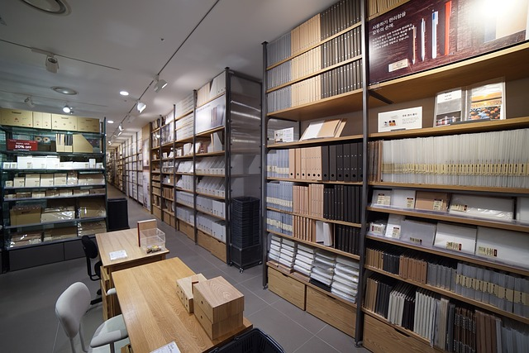


Slide 2

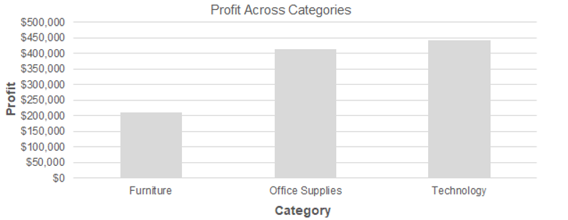
Which Category is the Most Profitable overall?

Slide 3

Highest and lowest performing product category?

Slide 4
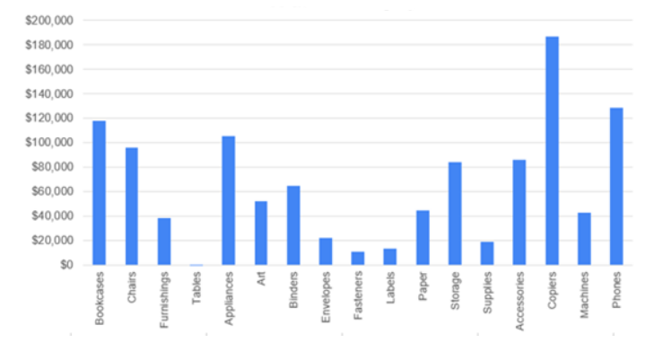
Overall Profit by Subcategory

Slide 5

Office Supplies: Labels earned the most profit, less overhead expenses, in 2019.
Furniture segment still found itself in the negative in overall profit and margin for tables in 2019 after returns were considered.
In 2018, Labels and Paper Office Supplies fared well overall.

Slide 6

TOP Customer Segment
Tamara Chand from the Corporate Customer segment; 153 orders, $9043.78 — the highest in the Superstore dataset.
-Raymond Buch of the Consumer segment 2nd TOP performing; placed 51 orders, $7411.68, made 0 returns.

